Slide 1
Testing Agile Based Software cont..
Prof. Durga Prasad Mohapatra
Dept. of CSE, NIT Rourkela
India

Slide 2
Agile Testing Life Cycle
Agile Testing Life Cycle is based on the ‘more is less’ principle which focuses on communication management among stakeholders.
The adoption of this principle results in quality software product as shown in next figure.
If communication between the tester and other stakeholder is very frequent and effective, then there would be very few doubts and more clarity.

Slide 3
Agile Testing Life Cycle cont..
This principle ensures that testing activities along with effective communication and collaboration among major stakeholders, such as business analyst, market evaluator, customer, and developer, result in software products having only few defects.

Slide 4
More is Less Principle
More cInteractions
Less Defects
Less Doubts
More Focus
Fig 1: More is less principle

Slide 5
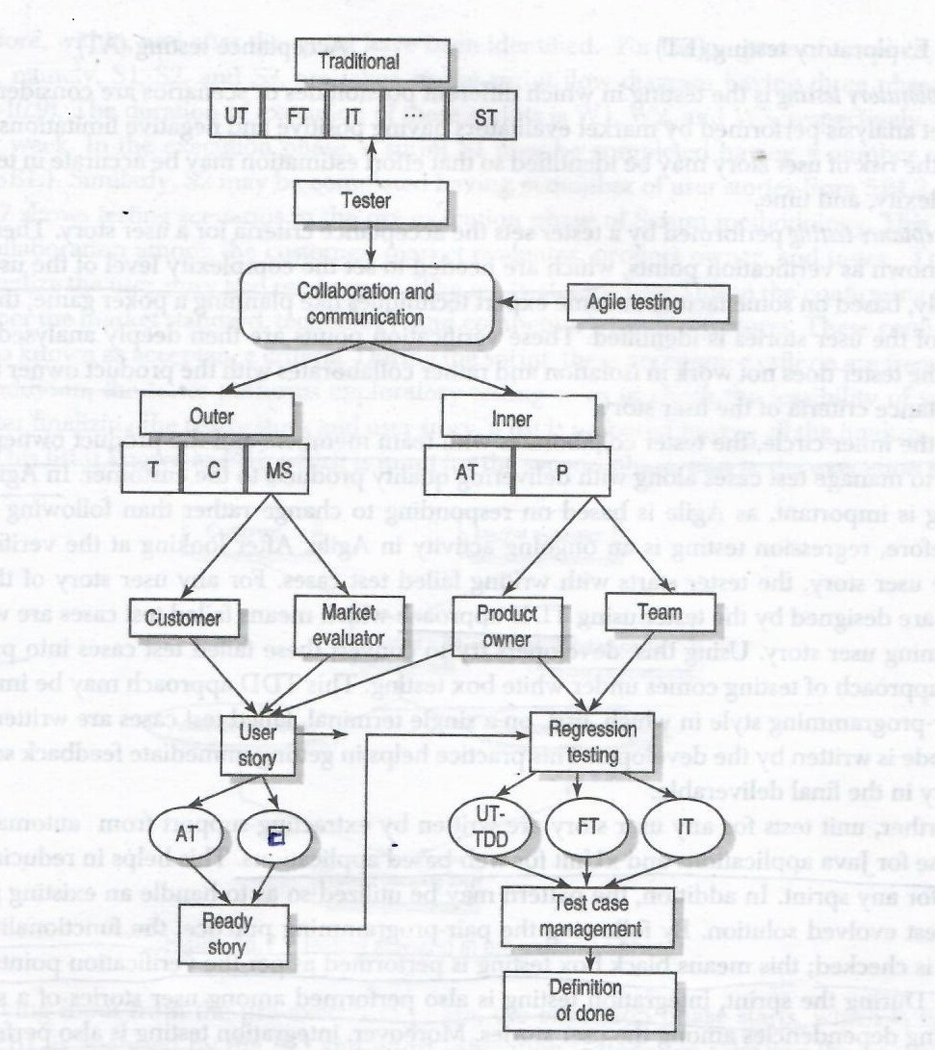
Fig 2: Agile testing life cycle

Slide 6
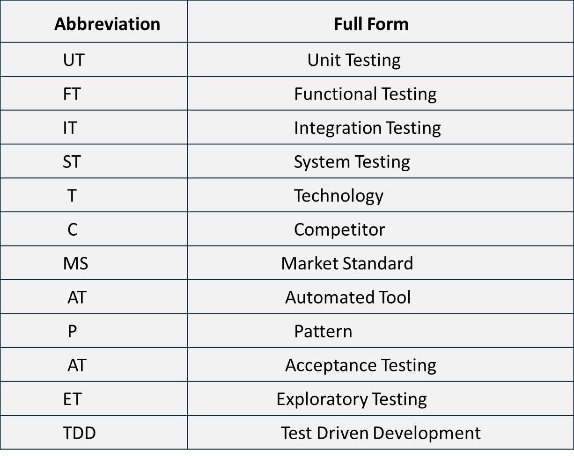
Agile Testing Abbreviations

Slide 7
Agile Testing Life Cycle cont..
An agile tester interacts and collaborates with 2 circles, namely an outer circle and inner circle.
The outer circle is connected to the outside world
In the outer circle the tester collaborates with customers and market evaluators.
Then convert the informal requirements into a formal set of requirements known as the user story.

Slide 8
Agile Testing Life Cycle cont …
Then the tester converts the user story into a ready story.
This ready story acts like a checklist at the time of verification or acceptance of the user story by the customer.
This ready story is the outcome of performing 2 types of testing.
Exploratory testing(ET)
Acceptance testing(AT)

Slide 9
Agile Testing Life Cycle cont..
Exploratory testing is the testing in which different possibilities or scenarios are considered/explored as per the market analysis performed by market evaluators having positive and negative limitations.
At the same time, the risk of user story may be identified so that effort estimation may be accurate in terms of effort, complexity, time.

Slide 10
Agile Testing Life Cycle cont..
Acceptance testing performed by a tester sets the acceptance criteria for a user story. These criteria also known as verification points, which are needed to set the complexity level of the user story. These verification points are then deeply analysed.
In this case also, the tester does not work in isolation and rather collaborates with the product owner to finalize the acceptance criteria of the user story.

Slide 11
Agile Testing Life Cycle cont..
In the inner circle, the tester collaborates with team members and product owner.
In Agile, regression testing is important, as Agile is based on responding to change rather than following a fixed plan.
So regression testing is an on going activity in Agile.

Slide 12
Agile Testing Life Cycle cont..
After looking at the verification points of the user story, the tester starts with writing failed test cases.
For any user story of the sprint, test cases are designed by the tester using Test Driven Development(TDD) approach which means failed test cases are written for the upcoming user story.

Slide 13
Test Driven Development
Add a test
TDD Rhythm-Test, Code ,Refactor

Slide 14
Test Driven Development cont..
Add a test
Run the test

Slide 15
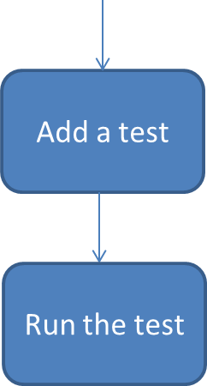
Test Driven Development cont..
pass

Slide 16
Test Driven Development cont..
pass
Fail

Slide 17
Test Driven Development cont..
pass
Fail
Make a little change
Run the test

Slide 18
Test Driven Development cont..
pass
Fail
Make a little change
Fail
Run the test
pass

Slide 19
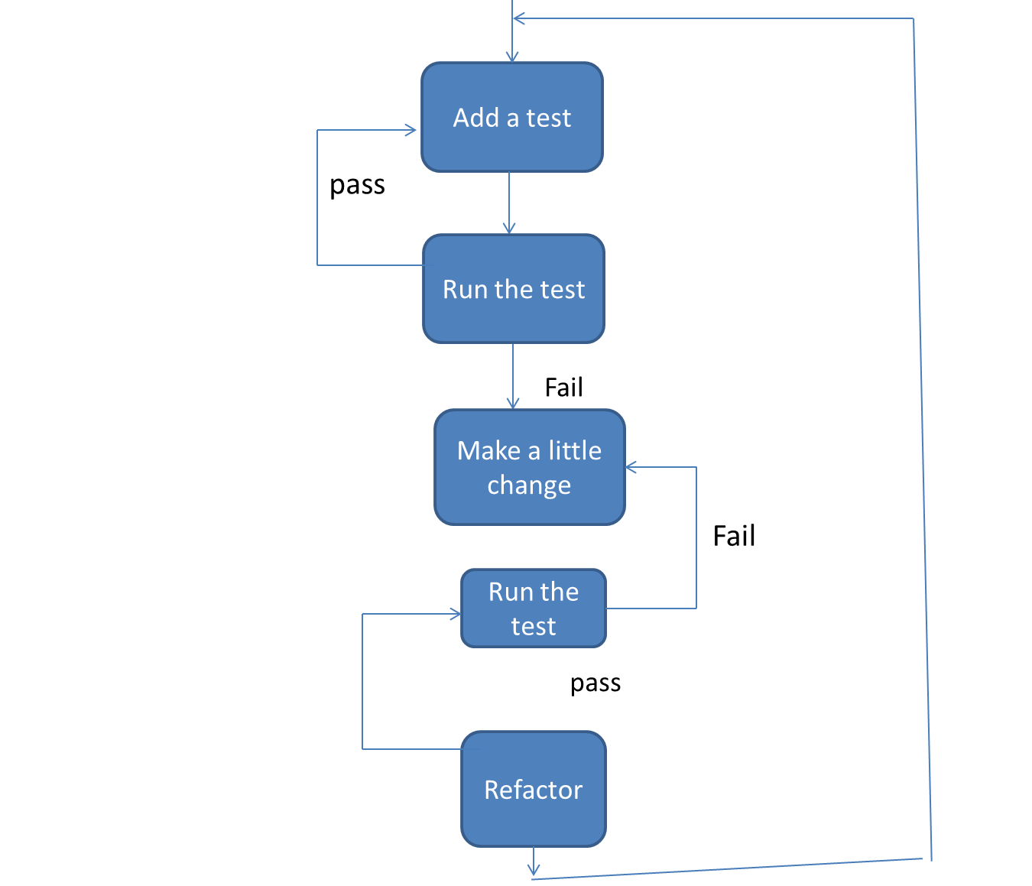
Test Driven Development cont..

Slide 20
Agile Testing Life Cycle cont..
Using this, developers try to convert these failed test cases into pass test cases.
This TDD approach may be implemented in a pair-programming style in which, first, on a single terminal, failed test cases are written, after which the code is written by the developer.
This practice helps in getting immediate feedback so as to embed quality in final deliverable.

Slide 21
Agile Testing Life Cycle cont..
Unit tests for any user story are written by extracting support from automated tools like eclipse for Java applications and xUnit for web-based applications.
This helps in reducing the overall time for any sprint.
In addition, the pattern may be utilized so as to handle an existing problem with the best evolved solution.

Slide 22
Agile Testing Life Cycle cont..
During the sprint, integration testing also performed among user stories of a sprint by considering dependencies among the user stories.
Moreover, integration testing is also performed among user stories of the different sprints.

Slide 23
Agile Testing Life Cycle cont..
Further, to manage test cases, effective regression techniques, such as regression test selection (RTS) and test case prioritization (TCP) are implemented to run only a subset of test cases out of all the test cases.
Finally, ‘definition of done’ is declared by the customer after matching the verification points of the ready story with the actual product.

Slide 24
Testing in scrum phases
Scrum methodology is based upon small duration sprints having small number of user stories listed in the sprint backlog list(SBL), which is a subset of PBL(product backlog list).
Testing in scrum is divided into 3 phases called
Pre-execution phase
Execution phase
Post-execution phase

Slide 25
Testing in scrum phases cont..
Here all the testing activities occurring before, within, after the sprint have been identified.
Here for simplicity, only 3 sprints S1, S2, S3 are taken in sprint flow diagram having 3 phases.
The duration of execution of these sprints is W1, W2, W3 respectively, where W stands for week.

Slide 26
Testing in scrum phases cont..
In the execution phase, a sprint S1 may be completed having ‘n’ number of user stories from SBL1.
Similarly, S2 may be completed having ,m, number of user stories from SBL2.

Slide 27
Testing Scenario in Pre-execution Phase
Market Evaluator
Customer
Tester
Product Owner
Acceptance
Testing
Exploratory Testing
Product Backlog List

Slide 28
Testing Scenario in Pre-execution Phase cont..
This phase starts with collaboration among the customer, market evaluator, product owner and tester.
They sit together to finalize the user story and ready story.
The ready story is based upon the conforming points which are as per the market standard, technology and competitor's product features.

Slide 29
Testing Scenario in Pre-execution Phase cont..
These conforming points are also known as acceptance criteria.
During the sprint the acceptance criteria are frequently checked.
In addition, the tester performs exploratory testing so as to check the feasibility of various scenarios.

Slide 30
Testing Scenario in Pre-execution Phase cont..
After finalizing the ready story and the user story, a list is prepared having all the finalized set of user stories.
This list is known as PBL, which is input for the second phase, that is the execution phase.

Slide 31
Testing Scenario in Execution Phase
Regression Testing
S1
IT1
SBL 1
UT
FT
…
W1
SBL 3
IT1
IT2
Product Backlog List
IT3
Regression Testing
SBL 2
UT
FT
…
IT2
S2
W2

Slide 32
Testing Scenario in Execution Phase cont..
After receiving input from the pre-execution phase, the execution phase starts.
PBL is analyzed by the PO(product owner) and the effort estimation is done for selecting the user stories for SBL1 and SBL2. SBL1 and SBL2 are executed in sprint S1 and S2 respectively.
In S1 the tester performs unit testing with TDD or white box testing, functional testing or black-box testing, regression testing, integration testing among dependent user stories, and many more depending on the requirements of customer.

Slide 33
Testing Scenario in Execution Phase cont..
The output of S1 is an integrated set of user stories, IT1 with regression test suite during W1 duration.
Similarly , in sprint S2, the same types of testing are performed--- an integrated set of user stories IT2 with regression test suite during W2 duration.

Slide 34
Testing Scenario in Execution Phase cont..
Further, these integrated set of user stories IT1 and IT2 are considered user stories In SBL3.
Further, there may be other user stories which need to be developed in W3 duration which are newly added features in the maintenance time of the product.
SBL3 is input for the post-execution phase.

Slide 35
Testing Scenario in Post-Execution Phase
S3
Regression Testing
Integration Testing
System Testing
Performance Testing
Usability Testing
Compatibility Testing
Security Testing
……………
(As per the customer Requirement)
W3
SBL 3
IT1
IT2
IT3

Slide 36
Testing Scenario in Post-Execution Phase cont..
In post-execution phase, user stories are selected from SBL3, based on the priority set by the customer, complexity level, risk level, or any other prioritization factor.
Various types of testing that are performed in S3 are integration of IT1 and IT2, functional testing, system testing, and regression testing depending on the modification suggested by the customer, if any.

Slide 37
Testing Scenario in Post-Execution Phase cont..
Other optional testing that may be performed in W3 duration are compatibility testing, security testing, performance testing, usability testing etc.
Finally, a software product is delivered to the customer.

Slide 38
Regression testing in Agile
Regression testing in Agile environment is practised under two major categories.
Sprint level regression testing (SLRT): Focuses on testing new functionalities that have been incorporated since the last production release.
End-to-end regression testing(EERT): Refers to the regression testing that incorporates all the fundamental functionalities.

Slide 39
Regression testing in Agile cont..
Each sprint cycle is followed by a small span of SLRT.
The completed code goes through further regression cycles but not released into production.
After few successful sprint cycles-typically 3 to 4 –the application goes through one round of EERT before being released to production.

Slide 40
Challenges to Agile testing
Frequent changes in agile may have crucial after-effects if necessary steps are not taken, so there is a need to perform regression testing using effective techniques so as to reduce the size of pending backlogs of user stories and the test suite.
The changes that are introduced later may have several unnoticed effects in the working system. These effects must be controlled in a planned manner by team members to deliver the quality.

Slide 41
Challenges to Agile testing cont..
In distributed Agile, testing using pair-programming practice may be cumbersome as the first team member of the pair may be at one location and the second member of the pair may be at different location.
In this scenario, other issues also arise, such as language barrier, cultural barrier, and time zone barrier for effective communication among team members of the sprint. So quality may lag in software products.
As the number of sprints increases, the test suite size also grows, hence, management of test cases becomes a problem in a distributed environment.

Slide 42
Agile Testing Tool
TestRail – A Modern Agile Testing Tool to Boost Your Software Testing Efforts.
Organizes test cases, manages test runs, tracks test results, and measures progress.
Helps you meet your quality goals and complete your tests on time.

Slide 43
Critical points for agile testing
Testing is very critical from agile perspective. Typically in scrum, there are many changes and test team must be capable of handling huge regression testing cycle as one progresses from iteration to iteration.
Understanding of requirements, creation of reusable test cases, integration testing along with regression testing are key factors in successful testing .

Slide 44
Critical points for agile testing cont..
Competencies/Maturity of Agile Development and Test Team
Development and Test Process Variability
Change Management and Communication
Test Process Flexibility
Focus on Business Objective
Stakeholder Maturity/Involvement

Slide 45
Competencies/Maturity of Agile Development and Test Team
For undertaking agile, one must have the teams, customer and management who psychologically accept agile approach.
It talks about ability to change very fast, build good working product and communicate with team members and stakeholders effectively as well as efficiently.
Agile implementation may prefer generalist approach as against specialist approach.
It needs people with very high maturity as well as technical competence to adapt to changing needs of customer.

Slide 46
Development and Test Process Variability
Every process has an inborn variability.
One my have to attack the generic reasons of variations while there may be some controls to identify special causes of variations.
One must be able to plot development and test process, and try to remove personal factor from the processes.

Slide 47
Change Management and Communication
Change is inevitable in agile. It flows from customer to development team and goes back to customer.
There must be a very close communication between development, test team, customer, and other stakeholders to adapt to changing scenario.
Requirement change must be welcomed and all people together must decide how customer can be served best.

Slide 48
Test Process Flexibility
Change is must in agile, and one may have to adapt to the changes. Test process is not an exception to it.
Different parts of software need different strategies of testing.
There may be different test plans or one may keep flexibility in a test plan to adapt to these changes. There may be changes in focus in each iteration.
Initially, there may be heavy unit testing, then it may have integration testing where different iterations come together.
It may be followed by heavy regression testing.

Slide 49
Focus on Business Objective
There is always a time pressure in agile development.
Pressure may come from stake holders to deliver things faster or it may come from development, if they get delayed.
One may have to focus on business while defining test process.
Cost-benefit analysis may be done when it come to defect fixes and release of software.
Nobody can find all defects but user must be protected from any accidental failure.
Testing has to achieve both extremes.

Slide 50
Stakeholder Maturity/Involvement
Agile development also needs a good maturity from stakeholders.
Internal and external service providers must understand and work with time pressure.
Good process of development and testing must be supported by tools and techniques required for agile implementation.
There may be some specific requirements of stake holders, and these requirements must be rearranged to suite agile development.

Slide 51
Summary
Discussed the agile testing life cycle in detail.
Highlighted the test driven development (TDD) approach.
Discussed agile testing in different scrum phases.
Explained regression testing in agile.
Presented some of challenges to agile testing.
Discussed some critical points for agile testing.

Slide 52
References
Naresh Chauhan, Software Testing: Principles and Practices, (Chapter – 16), Second Edition, Oxford University Press, 2018.

Slide 53
Thank You

